Slide 1

Project Title -Seasonal Agriculture Performance Analysis
INIGO AMALAN A
KARUNYA INSTITUTE OF TECHNOLOGY AND SCIENCES
AICTE STU ID :STU6825ff893751c1747320713

Slide 2

PROBLEM STATEMENT
Agricultural activities are influenced by seasonal variations in environmental conditions, farming practices, resource availability and market conditions. As a result, agricultural performance may differ from one season to another. However, raw agricultural data does not clearly explain how agricultural performance changes across seasons or what patterns can be observed in different seasonal conditions. The problem is to analyze the given agricultural dataset and investigate seasonal differences in agricultural performance by identifying meaningful patterns, trends, relationships and variations within the available data.

Slide 3
Project Description Seasonal Agriculture Performance Analysis analyzes agricultural data across Kharif, Rabi, and Zaid seasons to identify patterns in crop yield, environmental conditions, resource usage, revenue, and profit. Data analysis and visualization techniques are used to compare seasonal performance and generate data-driven insights for better agricultural planning.

Slide 4

WHO ARE THE END USERS?
Farmers – to understand seasonal crop performance and improve farming decisions.
Agricultural planners – to support seasonal planning and resource management.
Agricultural researchers – to study seasonal trends and agricultural patterns.
Government/agriculture departments – to support evidence-based agricultural planning.

Slide 5

Technology Used
Python
Google Colab
Pandas & NumPy – Data cleaning and analysis
Matplotlib & Seaborn – Data visualization
SciPy – Statistical analysis
CSV Dataset – Agricultural data source

Slide 6
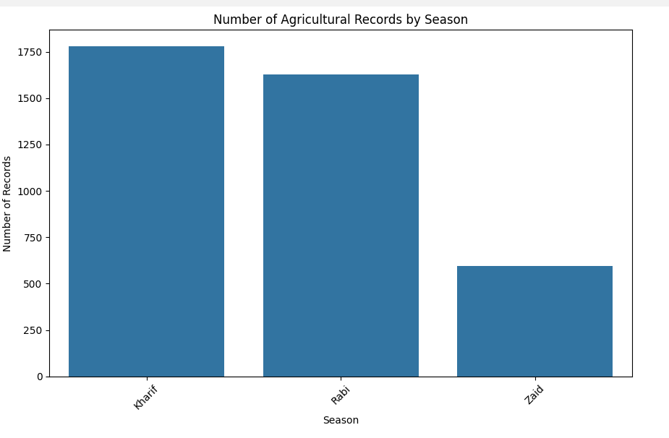
RESULTS
How does agricultural performance vary across seasons?
The chart shows that Kharif has the highest number of agricultural records, followed closely by Rabi, while Zaid has considerably fewer records.

Slide 7
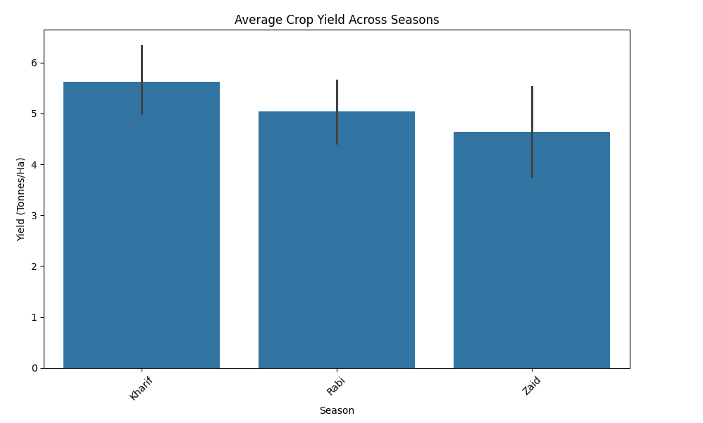
RESULTS
What major seasonal patterns can be observed?
Kharif season has the highest average crop yield (~5.6 tonnes/ha), followed by Rabi (~5.0 tonnes/ha), while Zaid has the lowest (~4.6 tonnes/ha). This indicates that crop productivity varies across seasons, with Kharif showing the strongest performance.

Slide 8
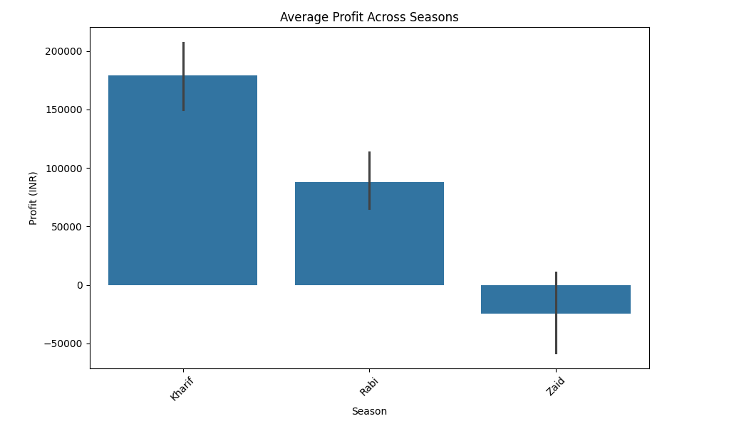
RESULTS
Profit Across Seasons
Kharif has the highest average profit (~₹1.78 lakh), followed by Rabi (~₹88,000). Zaid shows a negative average profit (~₹25,000), indicating that farming during Zaid was less economically profitable in this dataset.

Slide 9
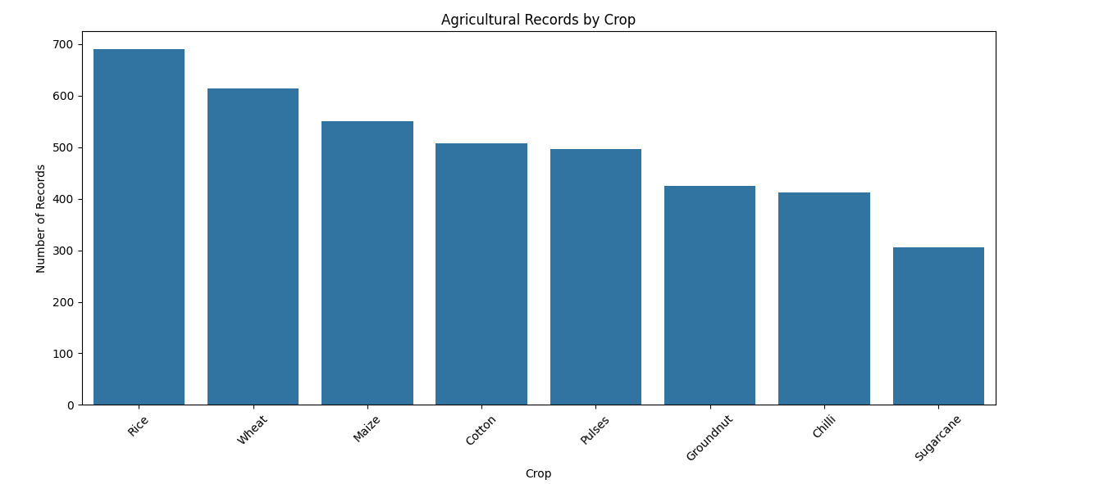
RESULTS
RECORDS OF DIFFERENT CROPS
Rice has the highest number of agricultural records (~690), followed by Wheat (~615) and Maize (~550). Sugarcane has the fewest records (~305). This shows that the dataset contains more observations for Rice and Wheat compared with the other crops.

Slide 10
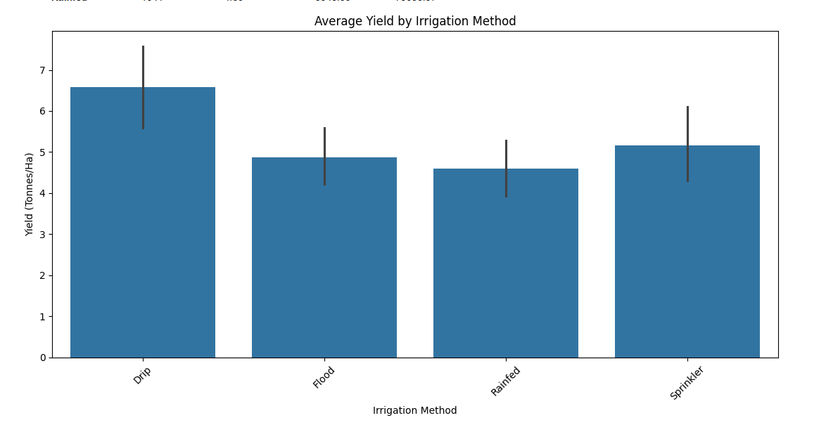
RESULTS
Variations Of Yield By Irrigation Method
Drip irrigation gives the highest average yield (~6.6 tonnes/ha), followed by Sprinkler (~5.2 tonnes/ha). Flood and Rainfed irrigation show lower yields (~4.9 and ~4.6 tonnes/ha respectively).

Slide 11
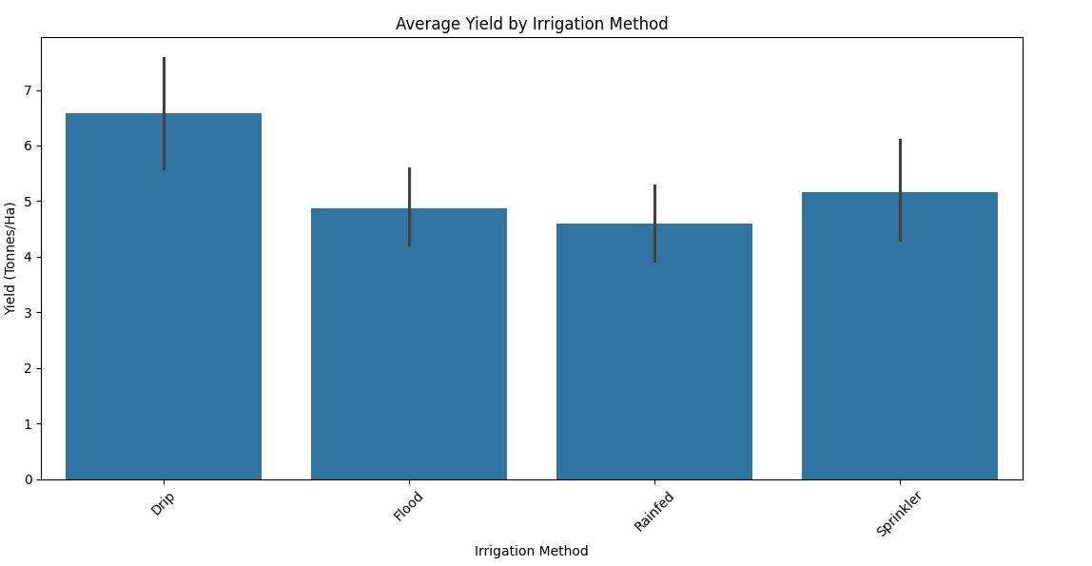
Result
Average Yield By Irrigation Method
Drip irrigation has the highest average yield (~6.6 tonnes/ha), while Rainfed has the lowest (~4.6 tonnes/ha). Flood and Sprinkler methods show moderate yields.

Slide 12
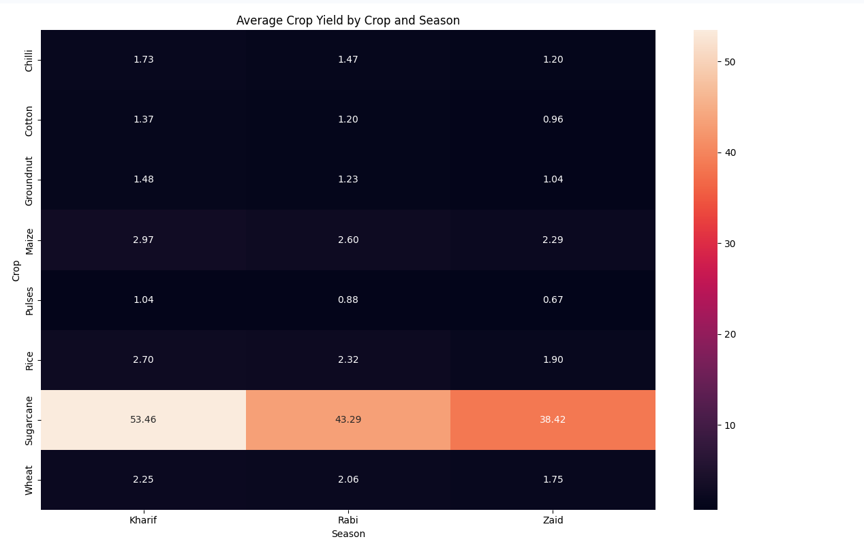
RESULT
Sugarcane has by far the highest average yield across all seasons, with its highest yield in Kharif (53.46 tonnes/ha). For every crop shown, Kharif has the highest yield, followed by Rabi and Zaid.
Average crop yield by Season

Slide 13
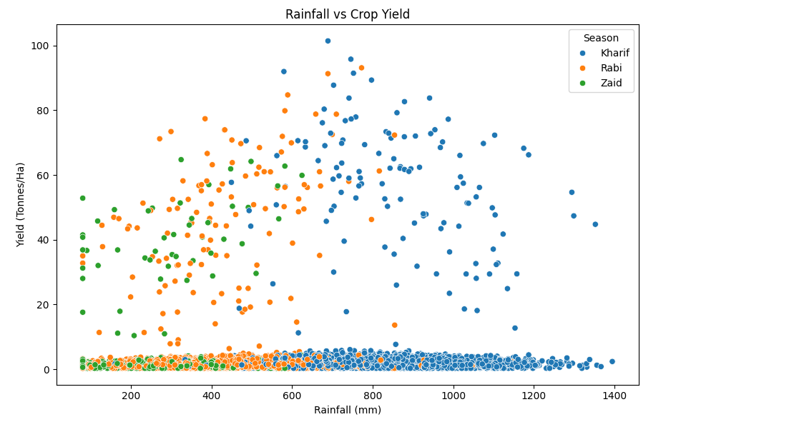
RESULTS
Affection of Rainfall in Crop Yield
The scatter plot shows that rainfall and crop yield do not have a clear linear relationship. Most observations have relatively low yields, while some higher-yield cases occur across different rainfall levels.

Slide 14
Future scope
Develop predictive models to forecast crop yield and profit for different seasons.
Integrate real-time weather and soil data for better analysis.
Build a farmer-friendly dashboard for monitoring agricultural performance.
Use machine learning to recommend suitable crops, irrigation methods, and resources.
Expand the analysis to include more regions and multiple years of agricultural data.

Slide 15
GitHub Link
https://github.com/InigoAmalan/VOIS-INTERNSHIP

Slide 16
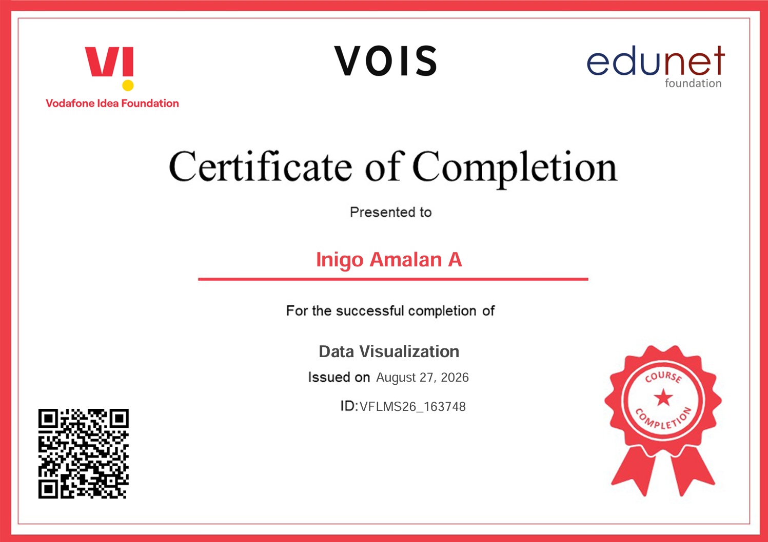
VOIS Course completion certificate - Course name- Data Visualization

Slide 17
Thank you
.
.

